Slide 1
Switching Power Supply
--Richard Lu

Slide 2
Content:
The Basic Circuit
    History
    Category
    Topology
    The main function part of circuit
    Power Factor Correction
    Others circuit
The Key Components
The Critical Test Items
Other Test Items

Slide 3
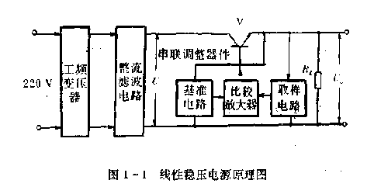
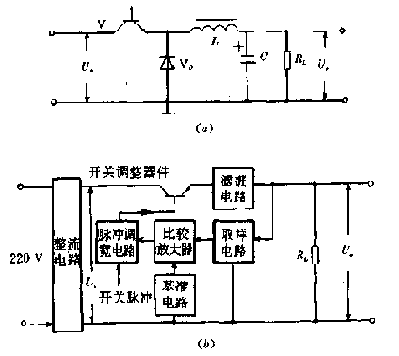
The Basic Circuit
History:
  1955(G.H.Royer)
        Switching Power Supply:

Slide 4
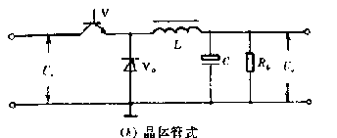
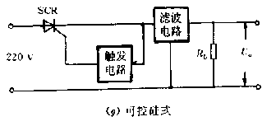
The Basic Circuit
Category:
      The motivating pattern;
      The modulation pattern;
      The current wave of switching tube;
      The type of switching tube;

Slide 5
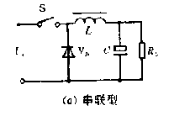
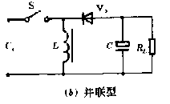
The Basic Circuit
Category:
      The connection between the inductor L and load Z;

Slide 6
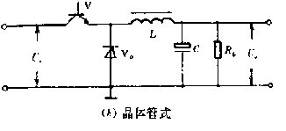
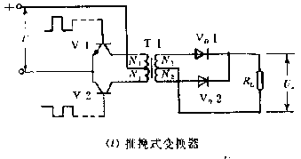
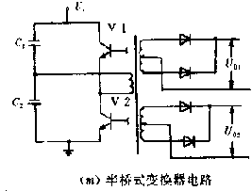
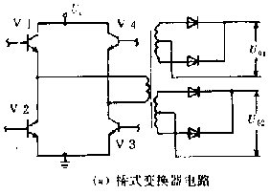
The Basic Circuit
Category:
      The connection of switching tube;

Slide 7
The Basic Circuit
Category:
      The comparability of Vout and Vin;
      The working style
      The circuit of construction

Slide 8
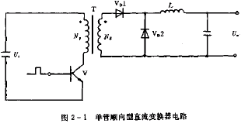
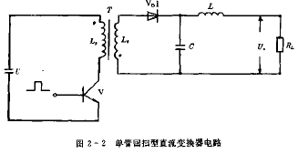
The Basic Circuit
Category:
      The polar of Transformer

Slide 9
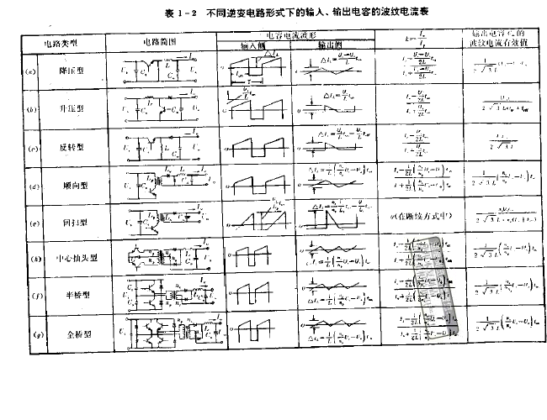
The Basic Circuit
Topology:

Slide 10
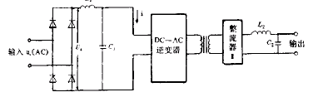
The Basic Circuit
The main function part of circuit
      First Rectified circuit;
      First Filter circuit;
      DC-AC convert circuit;
      Second Rectified circuit;
      Second Filter circuit;
      Ground;
      Isolation;
      Shield.

Slide 11
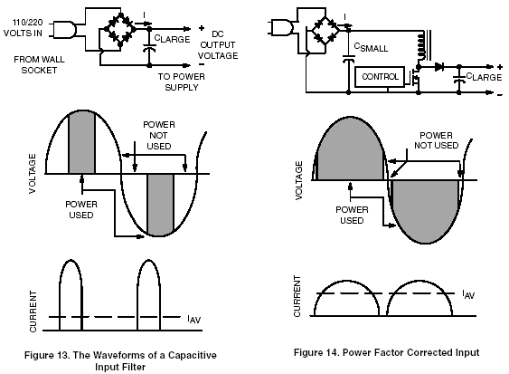
The Basic Circuit
Power Factor Correction

Slide 12
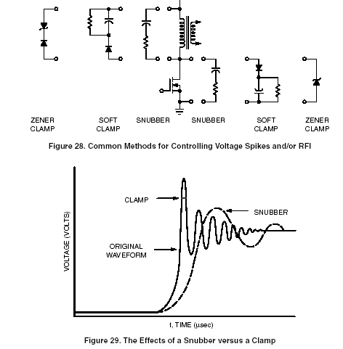
The Basic Circuit
The main function part of circuit
      Other circuit

Slide 13
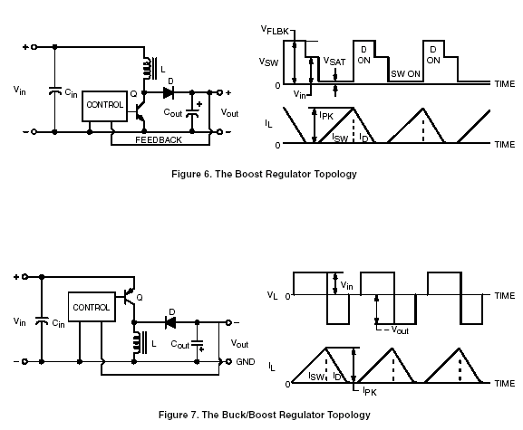
The Key Components
The analyse of classic circuit.

Slide 14
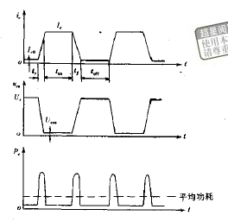
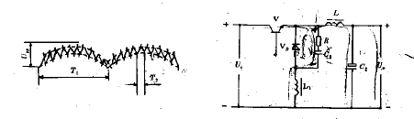
The Key Components
The lists of key components:
    The switching tube:
    Diode

Slide 15
The Critical Test Items
EMI:
    Harmonics
    The Continuous Disturbance Voltage
    The Radiated Emission(Power Disturbance)
EMS:
    SURGE

Slide 16
The other test items
EMI:
    Flicker
EMS:
    RS
    CS
    ESD
    EFT
    Dips

